Slide 1
Chapter 2: Assembly Language Programming
The PIC18 Microcontroller
Han-Way Huang
Minnesota State University, Mankato
June 2004
Copyright @ 2005 Delmar Thompson

Slide 2
Components of an Assembly Program
Assembler directives
Assembly language instructions
Comments
Elements of an Assembly Language Statement
Label
Mnemonics
Operands
- Comment
Copyright @ 2005 Delmar Thompson

Slide 3
Label Field
Must start from column 1 and followed by a tab, a space, a colon (:), or the
end of a line.
Must start with an alphabetic character or underscore (_).
May contain alphanumeric characters, underscores and question marks (?).
May contain up to 32 characters and is case-sensitive by default.
wait btfss sum,7 ; wait is a label
_again decf loop_cnt,F ; _again is a label
Copyright @ 2005 Delmar Thompson

Slide 4
Mnemonic Field
- Can be an assembly instruction mnemonic or assembly directive
- Must begin in column two or greater
Must be separated from the label by a colon, one or more spaces or tabs
addlw 0x10 ; addlw is the mnemonic field
loop incf 0x30,W,A ; incf is a mnemonic
false equ 0 ; equ is the mnemonic field
Copyright @ 2005 Delmar Thompson

Slide 5
The Operand Field
- The operand (s) follows the instruction mnemonic.
- Provides the operands for an instruction or arguments for an assembler directive.
Must be separated from the mnemonic field by one or more spaces or tabs.
Multiple operands are separated by commas.
movff 0x30,0x400 ; “0x30,0x400” is the operand field
decf loop_cnt,F ; label loop_cnt is the operand
true equ 1 ; ‘1’ is the argument for equ
Copyright @ 2005 Delmar Thompson

Slide 6
Comment field
Is optional
A comment starts with a semicolon.
All characters to the right of the semicolon are ignored by the assembler
Comments provide documentation to the instruction or assembler directives
A comment may explain the function of a single statement or the function of
a group of instructions
too_high decf mean,F,A ; prepare to search in the lower half
“too_high” is a label
“decf” is a mnemonic
“mean,F,A” is the operand field
“; prepare to search in the lower half” is a comment
Copyright @ 2005 Delmar Thompson

Slide 7
Assembler Directives
Control directives
Data directives
Listing directives
Macro directives
Object file directives
Copyright @ 2005 Delmar Thompson

Slide 8
Control Directives
if <expr> ; directives for conditional assembly
else
endif
Example.
if version == 100
movlw D’10’
movwf io1,A
else
movlw D’26’
movwf io2,A
endif
end ; indicates the end of the program
Copyright @ 2005 Delmar Thompson

Slide 9
[<label>] code [<ROM address>]
- Declares the beginning of a section of program code.
- If no label is specified, the section is named “.code”.
- The starting address of the section is either included in the directive or assigned at link time if not specified in the directive.
reset code 0x00
goto start
#define <name> [<string>] ; defines a text substitution string
#define loop_cnt 30
#define sum3(x,y,z) (x + y + z)
#define seed 103
#undefine <label> ; deletes a substitution string
Copyright @ 2005 Delmar Thompson

Slide 10
#include “<include_file>” (or #include <include_file>)
#include “lcd_util.asm” ; include the lcd_util.asm file from current directory
#include <p18F8680.inc> ; include the file p18F8680.inc from the installation
; directory of mplab.
radix <default_radix>
sets the default radix for data expression
the default radix values are: hex, dec, or oct
radix dec ; set default radix to decimal
Copyright @ 2005 Delmar Thompson

Slide 11
while <expr>
endw
The lines between while and endw are assembled as long as <expr> is true.
Data Directives
db <expr>,…,<expr> ; define 1 or multiple byte values
db “text_string” ; define a string
dw <expr>,…,<expr> ; define 1 or multiple word constants
dw “text_string” ; define a string
dt <expr>, …, <expr> ; generates a series of retlw instructions
<label> set <expr> ; assign a value (<expr>) to label
<label> equ <expr> ; defines a constant
Copyright @ 2005 Delmar Thompson

Slide 12
Data Directives Examples
led_pat db 0x30,0x80,0x6D,9x40,0x79,0x20,0x33,0x10,0x5B,0x08
msg1 db “Please enter your choice (1/2):”,0
array dw 0x1234,0x2300,0x40,0x33
msg2 dw “The humidity is “,0
results dt 1,2,3,4,5
sum_hi set 0x01
sum_lo set 0x00
TH equ 200
TL equ 30
Copyright @ 2005 Delmar Thompson

Slide 13
What is a macro?
A group of instructions that are grouped together and assigned a name
One or multiple arguments can be input to a macro
By entering the macro name, the same group of instructions can be duplicated in any place of the program.
User program is made more readable by using macros
User becomes more productive by saving the text entering time
Macro Directives
macro
endm
exitm
Copyright @ 2005 Delmar Thompson

Slide 14
Macro Definition Examples
eeritual macro ; macro name is eeritual
movlw 0x55 ; instruction 1
movwf EECON2 ; instruction 2
movlw 0xAA ; instruction 3
movwf EECON2 ; instruction 4
endm
Macro Call Example
eeritual ; this macro call causes the
; assembler to insert
; instruction 1 … instruction 4
Copyright @ 2005 Delmar Thompson

Slide 15
More Macro Examples
sum_of_3 macro arg1, arg2, arg3 ; WREG ← [arg1]+[arg2]+[arg3]
movf arg1,W,A
addwf arg2,W,A
addwf arg3,W,A
endm
sum_of_3 0x01, 0x02, 0x03 ; WREG ← [0x01] + [0x02] + [0x03]
Copyright @ 2005 Delmar Thompson

Slide 16
Object File Directives
banksel <label>
generate the instruction sequence to set active data bank to the one where
<label> is located
<label> must have been defined before the banksel directive is invoked.
bigq set 0x300
…
…
banksel bigq ; this directive will cause the assembler to
; insert the instruction movlb 0x03
Copyright @ 2005 Delmar Thompson

Slide 17
Object File Directives (continues)
[<label>] org <expr>
sets the program origin for subsequent code at the address defined in <expr>.
<label> will be assigned the value of <expr>.
reset org 0x00
goto start
…
start …
led_pat org 0x1000 ; led_pat has the value of 0x1000
db 0x7E,0x30,0x6D,0x79,0x33,0x5B,0x5F,0x70,0x7F,0x7B
Copyright @ 2005 Delmar Thompson

Slide 18
Object File Directives (continued)
processor <processor_type>
Sets the processor type
processor p18F8680 ; set processor type to PIC18F8680
Copyright @ 2005 Delmar Thompson

Slide 19
Program Development Procedure
Problem definition
Algorithm development using pseudo code or flowchart
Converting algorithm into assembly instruction sequence
Testing program using normal data, marginal data, and erroneous data
Algorithm Representation
Step 1
…
Step 2
…
Step 3
…
Copyright @ 2005 Delmar Thompson

Slide 20
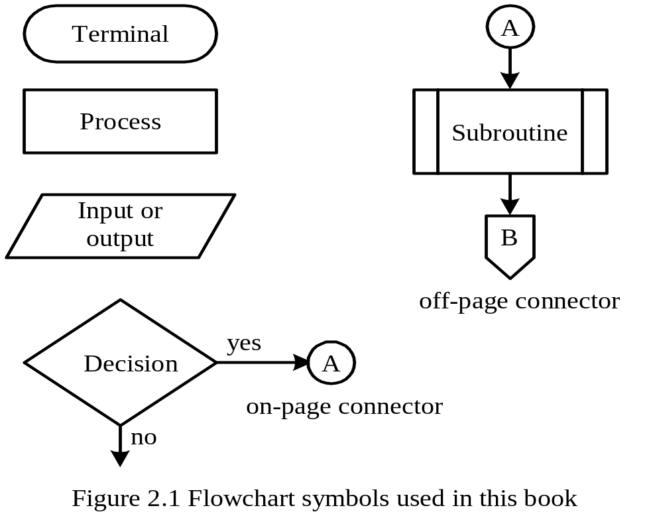
Flowchart Symbols
Copyright @ 2005 Delmar Thompson

Slide 21
Assembly Program Template
org 0x0000 ; program starting address after power on reset
goto start
org 0x08
… ; high-priority interrupt service routine
org 0x18
… ; low-priority interrupt service routine
start …
… ; your program
end
Copyright @ 2005 Delmar Thompson

Slide 22
Program Template Before Interrupts Have Been Covered
org 0x0000 ; program starting address after power on reset
goto start
org 0x08
retfie ; high-priority interrupt service routine
org 0x18
retfie ; low-priority interrupt service routine
start …
… ; your program
end
Copyright @ 2005 Delmar Thompson

Slide 23
Case Issue
The PIC18 instructions can be written in either uppercase or lowercase.
MPASM allows the user to include “p18Fxxxx.inc” file to provide register definitions for the specific processor.
All special function registers and bits are defined in uppercase.
The convention followed in this text is: using lowercase for instructions and
directives, using uppercase for special function registers.
Copyright @ 2005 Delmar Thompson

Slide 24
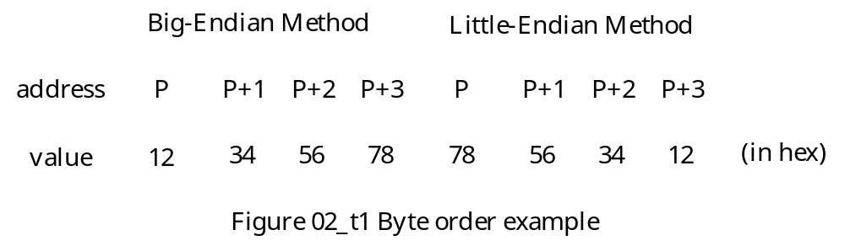
Byte Order Issue
This issue concerns how bytes are stored for multi-byte numbers.
The big-endian method stores the most significant byte at the lowest address and stores the least significant byte in the highest address.
The little-endian method stores the most significant byte of the number at the highest address and stores the least significant byte of the number in the lowest address.
The 32-bit number 0x12345678 will stored as follows with two methods:
Copyright @ 2005 Delmar Thompson

Slide 25
Programs for Simple Arithmetic Operations
Example 2.4 Write a program that adds the three numbers stored in data
registers at 0x20, 0x30, and 0x40 and places the sum in data register at 0x50.
Solution:
Algorithm:
Step 1
Load the number stored at 0x20 into the WREG register.
Step 2
Add the number stored at 0x30 and the number in the WREG register and
leave the sum in the WREG register.
Step 3
Add the number stored at 0x40 and the number in the WREG register and
leave the sum in the WREG register.
Step 4
Store the contents of the WREG register in the memory location at 0x50.
Copyright @ 2005 Delmar Thompson

Slide 26
The program that implements this algorithm is as follows:
#include <p18F8720.inc> ; can be other processor
org 0x00
goto start
org 0x08
retfie
org 0x18
retfie
start movf 0x20,W,A ; WREG ← [0x20]
addwf 0x30,W,A ; WREG ← [0x20] + [0x30]
addwf 0x40,W,A ; WREG ← [0x20] + [0x30] + [0x40]
movwf 0x50,A ; 0x50 ← sum (in WREG)
end
Copyright @ 2005 Delmar Thompson

Slide 27
Example 2.5 Write a program to add two 24-bit numbers stored at 0x10~0x12 and 0x13~0x15 and leave the sum at 0x20..0x22.
Solution:
#include <p18F8720.inc>
org 0x00
goto start
org 0x08
retfie
org 0x18
retfie
start movf 0x10,W,A ; WREG ← [0x10]
addwf 0x13,W,A ; WREG ← [0x13] + [0x10]
movwf 0x20,A ; 0x20 ← [0x10] + [0x13]
movf 0x11,W,A ; WREG ← [0x11]
addwfc 0x14,W,A ; WREG ← [0x11] + [0x14] + C flag
movwf 0x21,A ; 0x21 ← [WREG]
movf 0x12,W,A ; WREG ← [0x12]
addwfc 0x15,W,A ; WREG ← [0x12] + [0x15] + C flag
movwf 0x22,A ; 0x22 ← [WREG]
end
Copyright @ 2005 Delmar Thompson

Slide 28
Example 2.6 Write a program to subtract 5 from memory locations 0x10 to 0x13.
Solution:
Algorithm:
Step 1. Place 5 in the WREG register.
Step 2. Subtract WREG from the memory location 0x10 and leave the difference in the memory location 0x10.
Step 3. Subtract WREG from the memory location 0x11 and leave the difference in the memory location 0x11.
Step 4. Subtract WREG from the memory location 0x12 and leave the difference in the memory location 0x12.
Step 5. Subtract WREG from the memory location 0x13 and leave the difference in the memory location 0x13.
Copyright @ 2005 Delmar Thompson

Slide 29
The Program for Example 2.6
#include <p18F8720.inc>
org 0x00
goto start
org 0x08
retfie
org 0x18
retfie
start movlw 0x05 ; WREG ← 0x05
subwf 0x10,F,A ; 0x10 ← [0x10] – 0x05
subwf 0x11,F,A ; 0x11 ← [0x11] – 0x05
subwf 0x12,F,A ; 0x12 ← [0x12] – 0x05
subwf 0x13,F,A ; 0x13 ← [0x13] – 0x05
end
Copyright @ 2005 Delmar Thompson

Slide 30
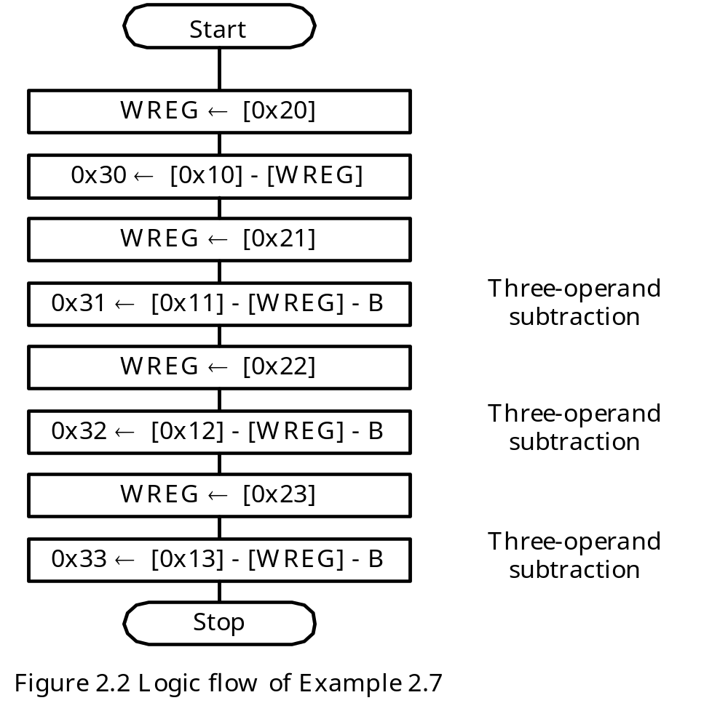
Example 2.7 Write a program that subtracts the number stored at 0x20..0x23 from the number stored at 0x10..0x13 and leaves the difference at 0x30..0x33.
Solution:
Copyright @ 2005 Delmar Thompson

Slide 31
The program for Example 2.7
#include <p18F8720.inc>
org 0x00
goto start
org 0x08
retfie
org 0x18
retfie
start movf 0x20, W, A ; 0x30 ← [0x10] – [0x20]
subwf 0x10, W, A ; “
movwf 0x30, A ; “
movf 0x21, W, A ; 0x31 ← [0x11] – [0x21]
subwfb 0x11, W, A ; “
movwf 0x31, A ; “
movf 0x22, W, A ; 0x32 ← [0x12] – [0x22]
subwfb 0x12, W, A ; “
movwf 0x32, A ; “
movf 0x23, W, A ; 0x33 ← [0x13] – [0x23]
subwfb 0x13, W, A ; “
movwf 0x33, A ; “
end
Copyright @ 2005 Delmar Thompson

Slide 32
Binary Coded Decimal (BCD) Addition
- Decimal digits are encoded using 4 bits
Two decimal digits are packed into a byte in memory
After each addition, one needs to use the daw instruction to adjust and correct the result.
Let data register 0x24 and 0x25 holds BCD numbers, the following instruction sequence adds these two BCD numbers and saves the sum in 0x30
movf 0x24,W,A
addwf 0x25,W,A
daw
movwf 0x30,A
Copyright @ 2005 Delmar Thompson

Slide 33
Example 2.9 Write an instruction sequence that adds the decimal numbers stored at
0x10...0x13 and 0x14...0x17 and stores the sum in 0x20..0x23.
Solution:
#include <p18F8720.inc>
…
start movf 0x10,W ; add the least significant byte
addwf 0x14,W ; “
daw ; adjust for valid BCD
movwf 0x20 ; save in the destination
movf 0x11 ; add the second to least significant byte
addwfc 0x15,W ; “
daw ; “
movwf 0x21 ; “
movf 0x12 ; add the second to most significant byte
addwfc 0x16 ; “
daw ; “
movwf 0x22 ; “
movf 0x13 ; add the most significant byte
addwfc 0x17 ; “
daw ; “
movwf 0x23 ; “
end
Copyright @ 2005 Delmar Thompson

Slide 34
Multiplication
PIC18 has two instructions for 8-bit multiplication: mulwf f and mullw k.
The products are stored in the PRODH:PRODL register pair.
The multiplication of numbers larger than 8 bits must be synthesized.
The following instruction sequence performs 8-bit multiplication operation:
movf 0x10,W,A
mulwf 0x11,A
movff PRODH,0x21 ; upper byte of the product
movff PRODL,0x20 ; lower byte of the product
- To perform multiplication operation on numbers longer than 8 bits, the operand must be broken down into 8-bit chunks. Multiple 8-bit multiplications are performed and the
resultant partial products are aligned properly and added together.
- Two 16-bit numbers P and Q can be broken down into as follows:
P = P_{H}P_{L}
Q = Q_{H}Q_{L}
Copyright @ 2005 Delmar Thompson

Slide 35
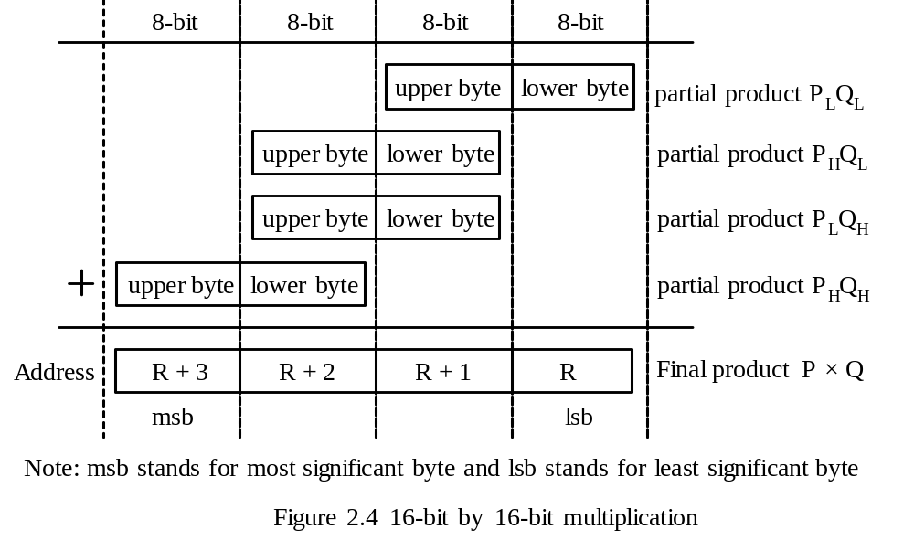
Adding the Partial Products
Copyright @ 2005 Delmar Thompson

Slide 36
Instruction sequence to multiply two numbers that are stored at N:N+1 and M:M+1:
movwf N,A ; "
movf M+1,W,A
mulwf N+1,A ; compute M_{H} × N_{H}
movff PRODL,PR+2
movff PRODH,PR+3
movf M,W,A ; compute M_{L} × N_{L}
mulwf N,A
movff PRODL,PR
movff PRODH,PR+1
movf M,W,A
mulwf N+1,A ; compute M_{L} × N_{H}
movf PRODL,W,A ; add M_{L} × N_{H} to PR
addwf PR+1,F,A ; "
movf PRODH,W,A ; "
addwfc PR+2,F,A ; "
movlw 0 ; "
addwfc PR+3,F,A ; add carry
movf M+1,W,A
mulwf N,A ; compute M_{H} × N_{L}
movf PRODL,W,A ; add M_{H} × N_{L} to PR
Copyright @ 2005 Delmar Thompson

Slide 37
addwf PR+1,F,A ; "
movf PRODH,W,A ; "
addwfc PR+2,F,A ; "
movlw 0 ; "
addwfc PR+3,F,A ; add carry
nop
end
Copyright @ 2005 Delmar Thompson

Slide 38
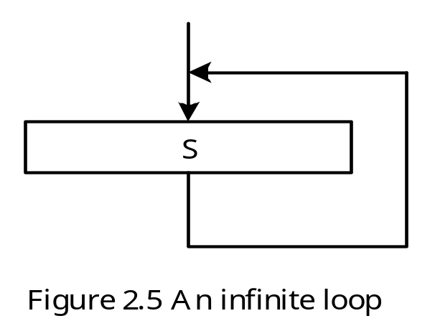
Program Loops
- Enable the microcontroller to perform repetitive operations.
- A loop may be executed a finite number of times or infinite number of times.
Program Loop Construct
Do S forever
Copyright @ 2005 Delmar Thompson

Slide 39
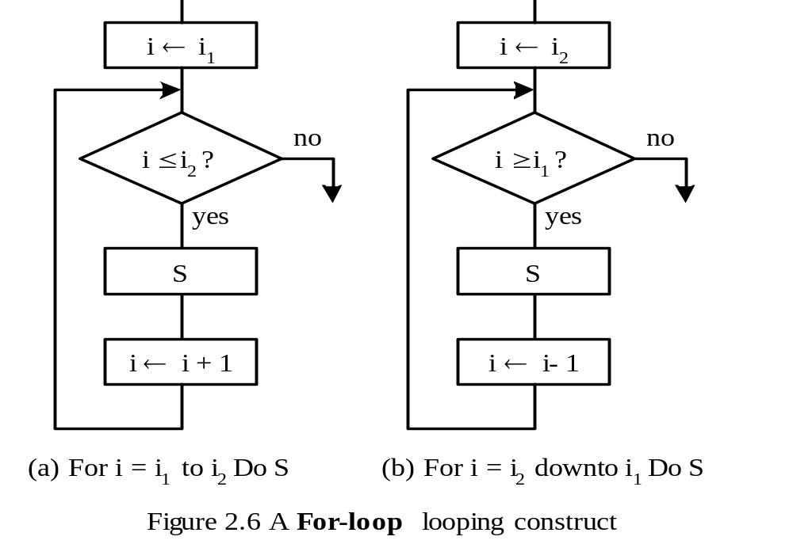
2. for i = n1 to n2 Do S or for i = n2 downto n1 do S
Copyright @ 2005 Delmar Thompson

Slide 40
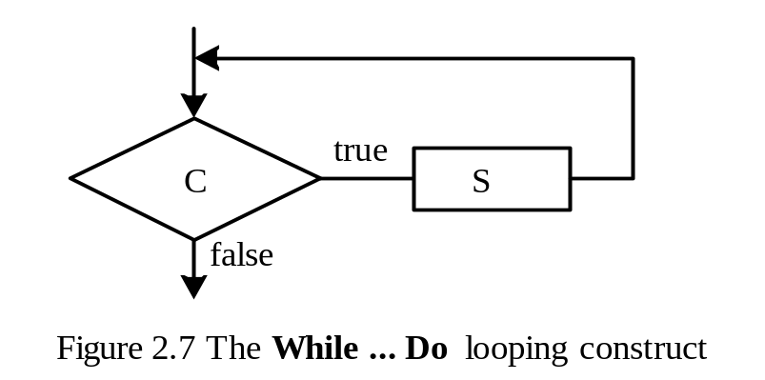
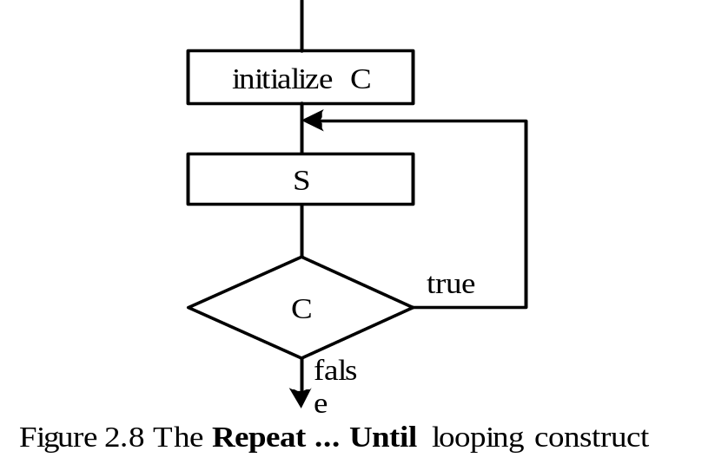
3. while C do S
4. repeat S until C
Copyright @ 2005 Delmar Thompson

Slide 41
Changing the Program Counter
Microcontroller executes instruction sequentially in normal condition.
PIC18 has a 21-bit program counter (PC) which is divided into three registers: PCL, PCH, and PCU.
PCL can be accessed directly. However, PCH and PCU are not directly accessible.
One can accessed the values of PCH and PCU indirectly by accessing the PCLATH and PCLATU.
Reading the PCL will cause the values of PCH and PCU to be copied into the PCLATH and PCLATU.
Writing the PCL will cause the values of PCLATCH and PCLATU to be written into the PCH and PCU.
In normal program execution, the PC value is incremented by either 2 or 4.
To implement a program loop, the processor needs to change the PC value by a value other than 2 or 4.
Copyright @ 2005 Delmar Thompson

Slide 42
Instructions for Changing Program Counter
BRA n: jump to the instruction with address equals to PC+2+n
B_{CC} n: jump to the instruction with address equals to PC+2+n if the condition code CC is true.
CC can be any one of the following:
C: C flag is set to 1
N: N flag is set to 1 which indicates that the previous operation result was negative
NN: N flag is 0 which indicates non-negative condition
NOV: V flag is 0 which indicates there is no overflow condition
NZ: Z flag is 0 which indicates the previous operation result was not zero
OV: V flag is 1 which indicates the previous operation caused an overflow
Z: Z flag is 1 which indicates the previous operation result was zero
goto n: jump to address represented by n
The destination of a branch or goto instruction is normally specified by a label.
Copyright @ 2005 Delmar Thompson

Slide 43
Instructions for Changing Program Counter (continued)
cpfseq f,a ; compare register f with WREG, skip if equal
cpfsgt f,a ; compare register f with WREG, skip if greater than or equal
cpfslt f,a ; compare register f with WREG, skip if less than
decfsz f,d,a ; decrement f, skip if 0
dcfsnz f,d,a ; decrement f, skip if not 0
incfsz f,d,a ; increment f, skip if 0
infsnz f,d,a ; increment f, skip if not 0
tstfsz f,a ; test f, skip if 0
btfsc f,b,a ; test bit b of register f, skip if 0
btfss f,b,a ; test bit b of register f, skip if 1
Instructions for changing register value by 1
incf f,d,a
decf f,d,a
Copyright @ 2005 Delmar Thompson

Slide 44
Examples of Program loops that execute n times
Example 1
i_cnt equ PRODL ; use PRODL as loop count
clrf i_cnt,A
i_loop …
… ; i_cnt is incremented in the loop
movlw n
cpfseq i_cnt,A ; compare i_cnt with WREG and skip if equal
goto i_loop ; executed when i_cnt ≠ loop limit
Copyright @ 2005 Delmar Thompson

Slide 45
Example 2
n equ 20 ; n has the value of 20
lp_cnt set 0x10 ; assign file register 0x10 to lp_cnt
…
movlw n
movwf lp_cnt ; prepare to repeat the loop for n times
loop … ; program loop
… ; “
decfsz lp_cnt,F,A ; decrement lp_cnt and skip if equal to 0
goto loop ; executed if lp_cnt ≠ 0
Copyright @ 2005 Delmar Thompson

Slide 46
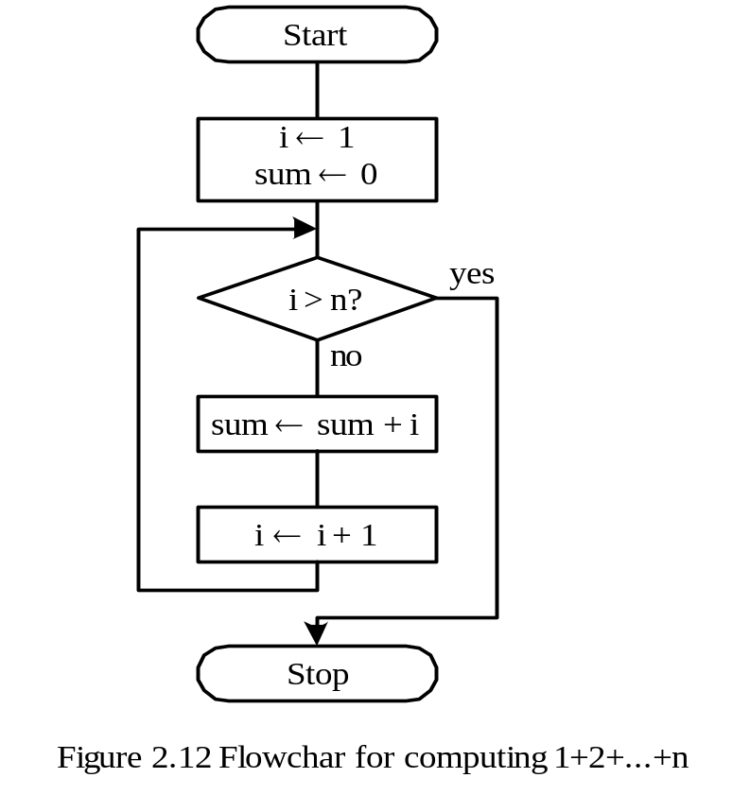
Example 2.12 Write a program to compute 1 + 2 + 3 + … + n and save the sum at 0x00 and 0x01.
Solution:
1. Program logic
Copyright @ 2005 Delmar Thompson

Slide 47
Program of Example 2.12 (in for i = n1 to n2 construct)
#include <p18F8720.inc>
radix dec
n equ D'50'
sum_hi set 0x01 ; high byte of sum
sum_lo set 0x00 ; low byte of sum
i set 0x02 ; loop index i
org 0x00 ; reset vector
goto start
org 0x08
retfie
org 0x18
retfie
start clrf sum_hi,A ; initialize sum to 0
clrf sum_lo,A ; "
clrf i,A ; initialize i to 0
incf i,F,A ; i starts from 1
sum_lp movlw n ; place n in WREG
cpfsgt i,A ; compare i with n and skip if i > n
bra add_lp ; perform addition when i ≤ 50
bra exit_sum ; it is done when i > 50
Copyright @ 2005 Delmar Thompson

Slide 48
add_lp movf i,W,A ; place i in WREG
addwf sum_lo,F,A ; add i to sum_lo
movlw 0
addwfc sum_hi,F,A ; add carry to sum_hi
incf i,F,A ; increment loop index i by 1
bra sum_lp
exit_sum nop
bra exit_sum
end
Copyright @ 2005 Delmar Thompson

Slide 49
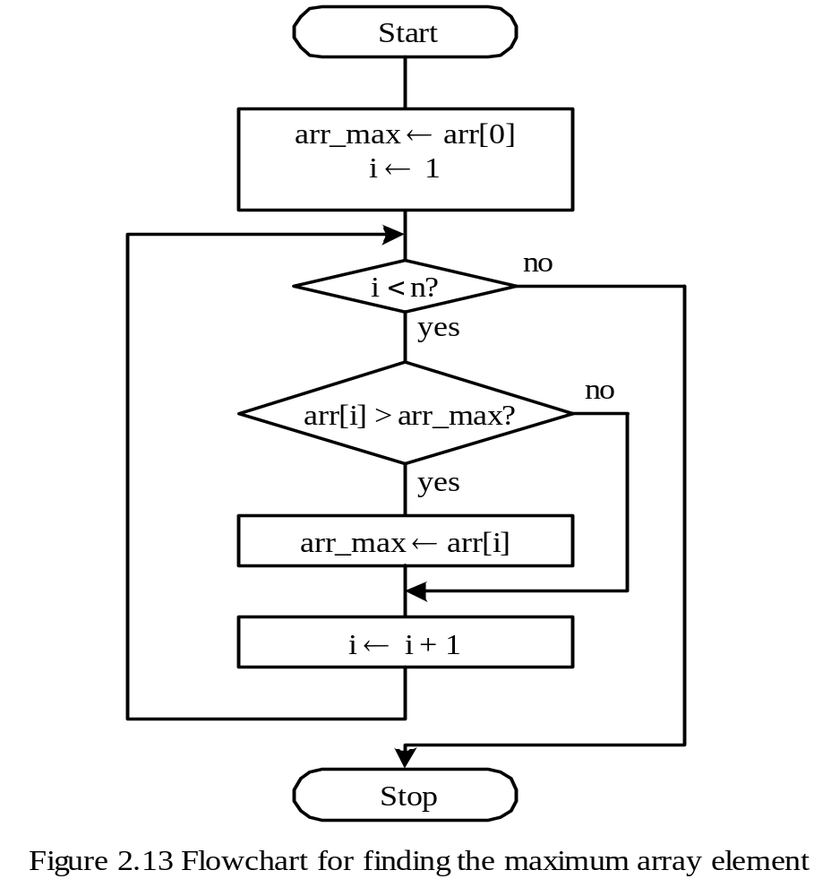
Example 2.13 Write a program to find the largest element stored in the array that is stored in data memory locations from 0x10 to 0x5F.
Copyright @ 2005 Delmar Thompson

Slide 50
Program for Example 2.13
arr_max equ 0x00
i equ 0x01
n equ D'80' ; the array count
#include <p18F8720.inc>
org 0x00
goto start
org 0x08
retfie
org 0x18
retfie
start movff 0x10,arr_max ; set arr[0] as the initial array max
lfsr FSR0,0x11 ; place address of arr[1] in FSR0
clrf i,A ; initialize loop count i to 0
again movlw n-1 ; number of comparisons to be made
; the next instruction implements the condition C (i = n)
cpfslt i,A ; skip if i < n-1
bra done ; all comparisons have been done
; the following 7 instructions update the array max
movf POSTINC0,W
Copyright @ 2005 Delmar Thompson

Slide 51
cpfsgt arr_max,A ; is arr_max > arr[i]?
bra replace ; no
bra next_i ; yes
replace movwf arr_max,A ; update the array max
next_i incf i,F,A
goto again
done nop
end
Copyright @ 2005 Delmar Thompson

Slide 52
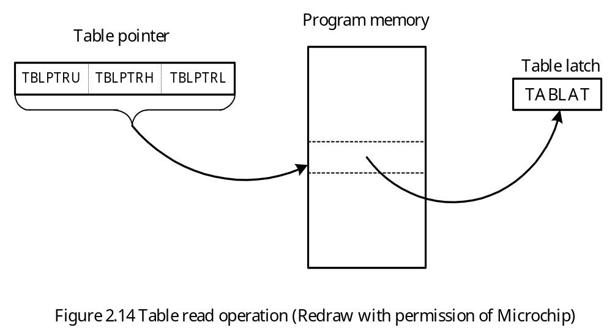
Reading and Writing Data in Program Memory
PIC18 provides TBLRD and TBLWT instructions for accessing data in program memory.
The operations of reading data from and writing data into program memory are shown in Figure 2.14 and 2.15.
Copyright @ 2005 Delmar Thompson

Slide 53
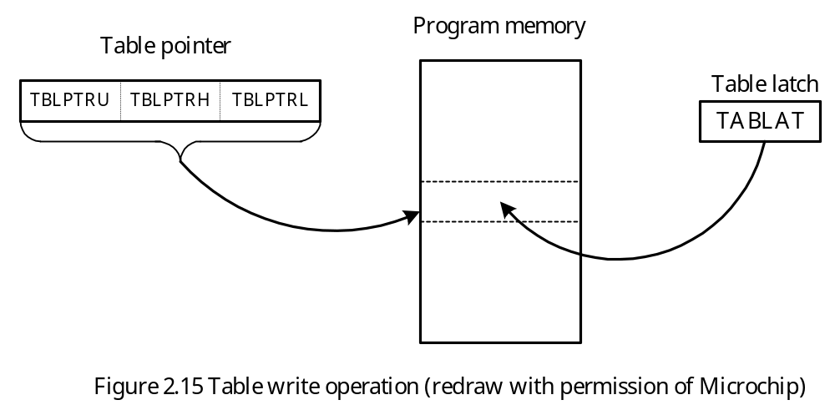
The table pointer consists of three registers:
TBLPTRU (6 bits)
TBLPTRH (8 bits)
TBLPTRL (8 bits)
Copyright @ 2005 Delmar Thompson

Slide 54
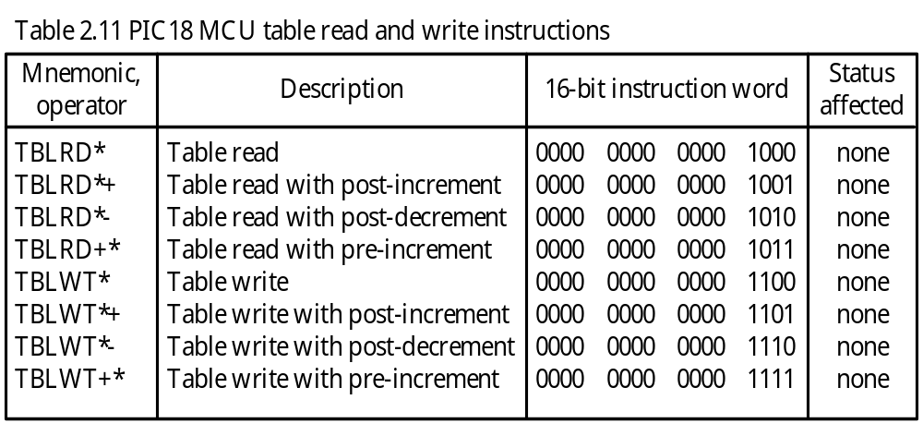
Versions of table read and table write instructions
Copyright @ 2005 Delmar Thompson

Slide 55
Reading the program memory location prog_loc involves two steps:
Step 1. Place the address of prog_loc in TBLPTR registers
movlw upper prog_loc
movwf TBLPTRU,A
movlw high prog_loc
movwf TBLPTRH,A
movlw low prog_loc
movwf TBLPTRL,A
Step 2. Perform a TBLRD instruction.
tblrd
The TBLPTR registers can be incremented or decremented before or after the read or write operations as shown in Table 2.11.
Copyright @ 2005 Delmar Thompson

Slide 56
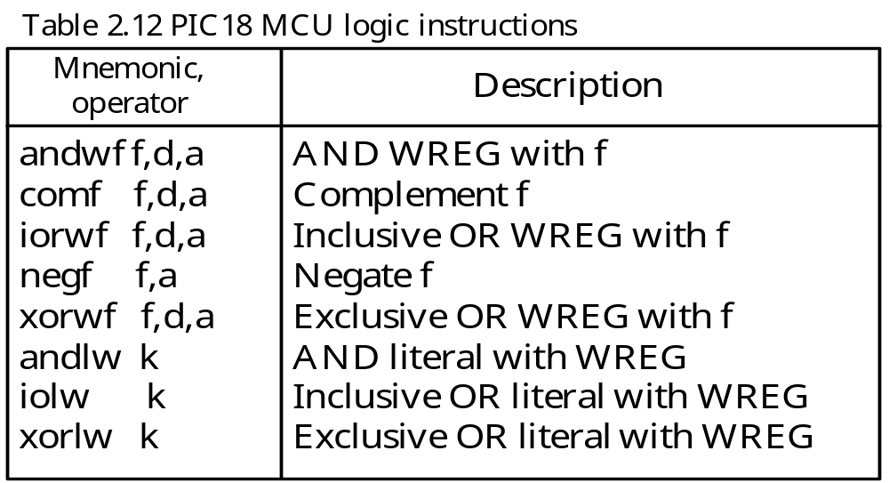
Logic Instructions
Applications of Logic Instructions
Set a few bits in a byte
Clear certain bits in a byte
Toggle certain bits in a byte
Copyright @ 2005 Delmar Thompson

Slide 57
To set bits 7, 6, and 0 of PORTA to 1
movlw B’11000001’
iorwf PORTA,F,A
To clear bits 4, 2, and 1 of PORTB to 0
movlw B’11101001
andwf PORTB,F,A
To toggle bits odd bits of PORTC
movlw B’10101010’
xorwf PORTC
Copyright @ 2005 Delmar Thompson

Slide 58
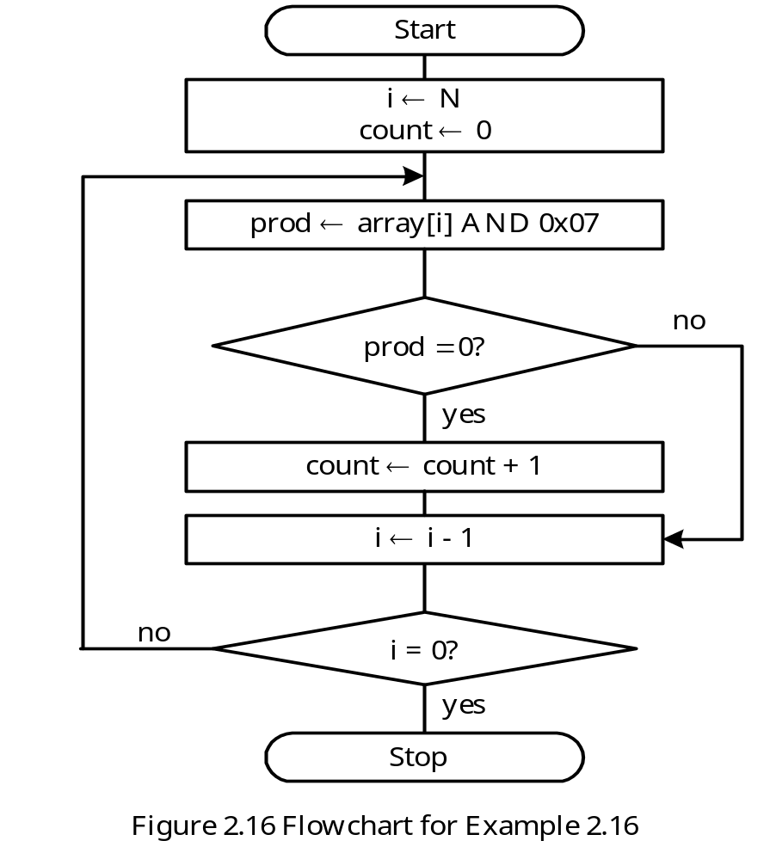
Example 2.16 Write a program to find out the number of elements in an array of 8-bit
elements that are a multiple of 8. The array is in the program memory.
Solution:
A number must have the lowest 3 bits equal to 0 to be a multiple of 8
Use the Repeat S until C looping construct
Copyright @ 2005 Delmar Thompson

Slide 59
#include <p18F8720.inc>
ilimit equ 0x20 ; loop index limit
count set 0x00
ii set 0x01 ; loop index
mask equ 0x07 ; used to masked upper five bits
org 0x00
goto start
… ; interrupt service routines
start clrf count,A
movlw ilimit
movwf ii ; initialize ii to ilimit
movlw upper array
movwf TBLPTRU,A
movlw high array
movwf TBLPTRH,A
movlw low array
movwf TBLPTRL,A
movlw mask
i_loop tblrd*+ ; read an array element into TABLAT
andwf TABLAT,F,A
bnz next ; branch if not a multiple of 8
Copyright @ 2005 Delmar Thompson

Slide 60
incf count,F,A ; is a multiple of 8
next decfsz ii,F,A ; decrement loop count
bra i_loop
nop
array db 0x00,0x01,0x30,0x03,0x04,0x05,0x06,0x07,0x08,0x09
db 0x0A,0x0B,0x0C,0x0D,0x0E,0x0F,0x10,0x11,0x12,0x13
db 0x14,0x15,0x16,0x17,0x18,0x19,0x1A,0x1B,0x1C,0x1D
db 0x1E,0x1F
end
Copyright @ 2005 Delmar Thompson

Slide 61
Using Program Loops to Create Time Delays
The PIC18 uses a crystal oscillator or a RC circuit to generate the clock signal needed to control its operation.
The instruction execution time is measured by using the instruction cycle clock.
One instruction cycle is equal to four times the crystal oscillator clock period.
Select an appropriate instruction that will take a multiple of 10 or 20 instruction cycles to execute.
A desirable time delay is created by repeating the chosen instruction sequence for certain number of times.
Copyright @ 2005 Delmar Thompson

Slide 62
A Macro to Repeat An Instruction for Certain Number of Times
dup_nop macro kk ; duplicate the nop instruction kk times
variable i
i = 0
while i < kk
nop ; takes 1 instruction cycle time
i += 1
endw
endm
To create 0.5 ms time delay with 40 MHz crystal oscillator
radix dec
loop_cnt equ PRODL
movlw 250
movlw loop_cnt,A
again dup_nop 17 ; insert 17 nop instructions
decfsz loop_cnt,F,A ; 1 instruction cycle
bra again ; 2 instruction cycles
Copyright @ 2005 Delmar Thompson

Slide 63
Example 2.18 Write a program to create a time delay of 100 ms for the demo board that uses a 40 MHz crystal oscillator to operate.
Solution: Repeat the previous instruction sequence for 200 times can create a 100 ms time delay.
radix dec
lp_cnt1 equ 0x21
lp_cnt2 equ 0x22
movlw 200
movwf lp_cnt1,A
loop1 movlw 250
movwf lp_cnt2,A
loop2 dup_nop 17 ; 17 instruction cycles
decfsz lp_cnt2,F,A ; 1 instruction cycle (2 when [lp_cnt1] = 0)
bra loop2 ; 2 instruction cycles
decfsz lp_cnt1,F,A
bra loop1
Copyright @ 2005 Delmar Thompson

Slide 64
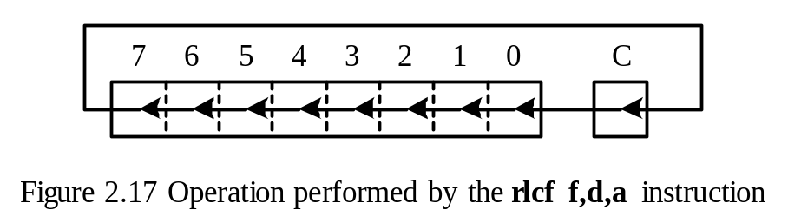
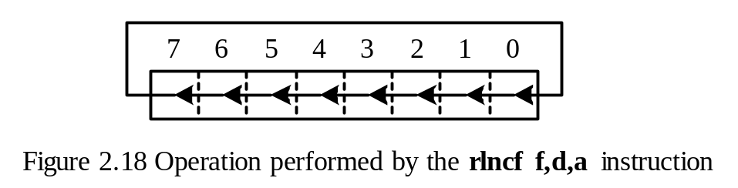
Rotate Instructions
rlcf f, d, a ; rotate left f through carry
rlncf f, d, a ; rotate left f ( not trough carry)
Copyright @ 2005 Delmar Thompson

Slide 65
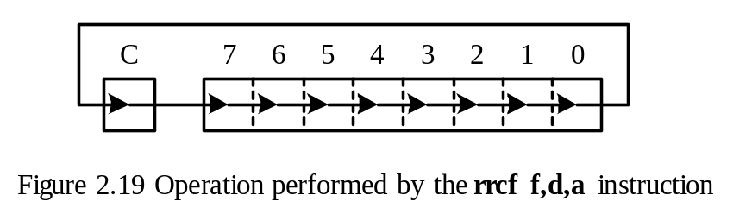
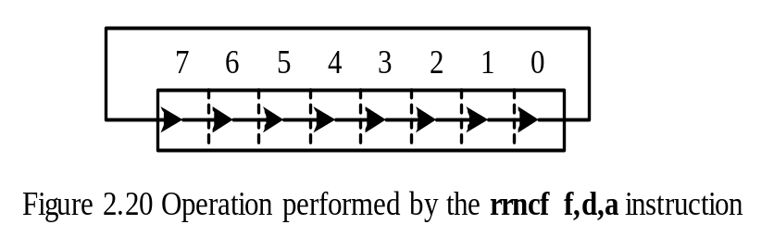
rrcf f, d, a ; rotate right f through carry
rrncf f, d, a ; rotate right f (not through carry)
Copyright @ 2005 Delmar Thompson

Slide 66
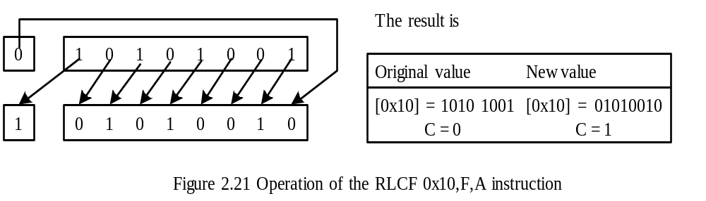
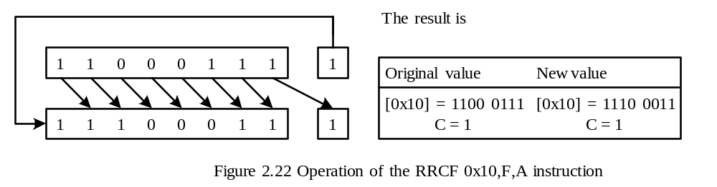
Example 2.19 Compute the new values of the data register 0x10 and the C flag after the
execution of the rlcf 0x10,F,A instruction. [0x10] = 0xA9, C = 1
Solution:
Example 2.20 Compute the new values of the data register 0x10 and the C flag after the
execution of the rrcf 0x10,F,A instruction. [0x10] = 0xC7, C = 1
Solution:
Copyright @ 2005 Delmar Thompson

Slide 67
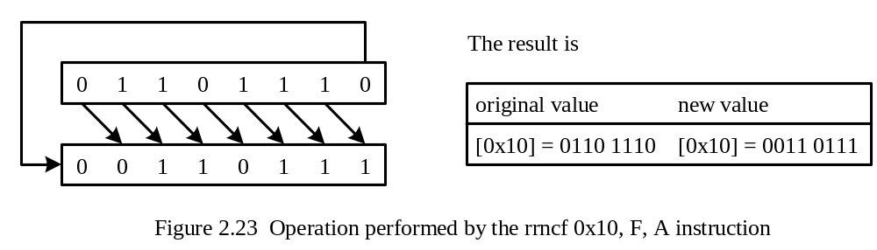
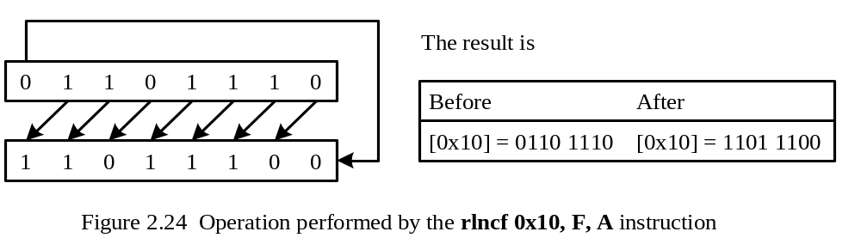
Example 2.21 Compute the new values of the data memory location 0x10 after the
execution of the rrncf 0x10,F,A instruction and the rlncf 0x10,F,A instruction,
respectively. [0x10] = 0x6E
Solution:
Copyright @ 2005 Delmar Thompson

Slide 68
Bit Operation Instructions
bcf f, b, a ; clear bit b of register f
bsf f, b, a ; set bit b of register f
btg f, b, a ; toggle bit b of register f
Examples
bcf STATUS,C,A ; clear the C flag of the STATUS register
bsf sign,0,A ; set the bit 0 of register sign to 1
btg sign,0,A ; toggle bit 0 of register sign (0 to 1 or 1 to 0)
Copyright @ 2005 Delmar Thompson

Slide 69
Perform Multiplication by Shift Left Operations
Multiply the 3-byte number store at 0x00…0x02 by 8
movlw 0x03 ; set loop count to 3
loop bcf STATUS, C, A ; clear the C flag
rlcf 0x00, F, A ; shift left one place
rlcf 0x01, F, A ; “
rlcf 0x02, F, A ; “
decfsz WREG,W,A ; have we shifted left three places yet?
goto loop ; not yet, continue
Copyright @ 2005 Delmar Thompson

Slide 70
Perform Division by Shifting to the Right
Divide the 3-byte number stored at 0x10…0x12
movlw 0x04 ; set loop count to 4
loop bcf STATUS, C, A ; shift the number to the right 1 place
rrcf 0x12, F, A ; “
rrcf 0x11, F, A ; “
rrcf 0x10, F, A ; “
decfsz WREG,W,A ; have we shifted right four places yet?
goto loop ; not yet, continue
Copyright @ 2005 Delmar Thompson

